Slide 1
IEEE's Signal Processing Society Camera Model Identification Kaggle Competition
Final submission deadline: February 8, 2018
Prizes: $12,000, $8,000, $5,000
582 teams
Presentation by Stan Kriventsov
March 22, 2018

Slide 2
About me
Ph.D in power electronics from Penn State (2004)
M.S. in computer science (AI) from Tulane University (2007)
10 years as a professional online poker player
Have been studying machine learning over the last 6 months, looking for a job in this field
My blog: www.kriventsov.com

Slide 3
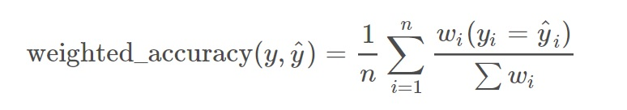
Competition: Problem Statement
Build an algorithm that identifies which camera model captured an image by using traces intrinsically left in the image (not image metadata)
Evaluation metric – weighted accuracy:
n is the number of samples in the test set; the weights are 0.7 for unaltered images and 0.3 for altered images

Slide 4
Motivation
Camera images are often used as evidence
However, it is easy to alter images by splicing together content from two different cameras
Image metadata can also be easily changed
Thus, an algorithm is needed for reliable identification of cameras based on image contents

Slide 5
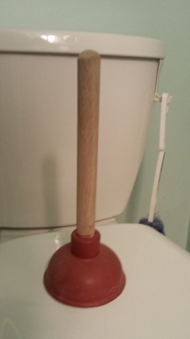
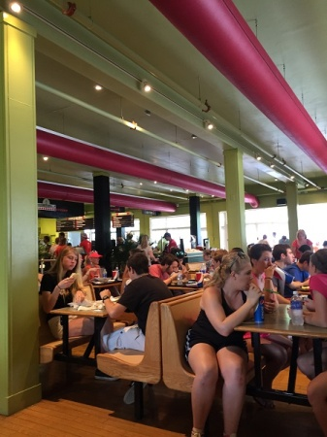
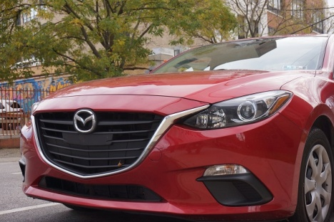
Training Dataset
10 popular camera models used in the training set (Sony NEX-7 mirrorless camera and 9 smartphone cameras from Motorola, Apple, LG, HTC and Samsung)
275 full high-resolution JPEG images from each device, single device per model (about 10GB total data)
Use of external training data allowed

Slide 6
Test Dataset
Same 10 models of devices used for the test set, but different device of the same model
Smaller images (512x512 pixel blocks cropped from the center) in TIF format
Half of the images altered (marked as such without specifying the method)
Possible alterations:
JPEG compression with quality factor 70 or 90
resizing (via bicubic interpolation) by a factor of 0.5, 0.8, 1.5 or 2.0
gamma correction using gamma 0.8 or 1.2

Slide 7
Machine Learning for Image Recognition and Processing
The ImageNet project (2009) - a large database of images designed for use in visual object recognition software research
The annual ImageNet Large Scale Visual Recognition Challenge (ILSVRC) – distinguish among 1000 categories from a dataset of about 500,000 images
In 2011, a good ILSVRC classification error rate was 25%
In 2012, a deep convolutional neural net achieved 16% error rate
In 2017, 29 of 38 competing teams got less than 5% of the labels wrong

Slide 8
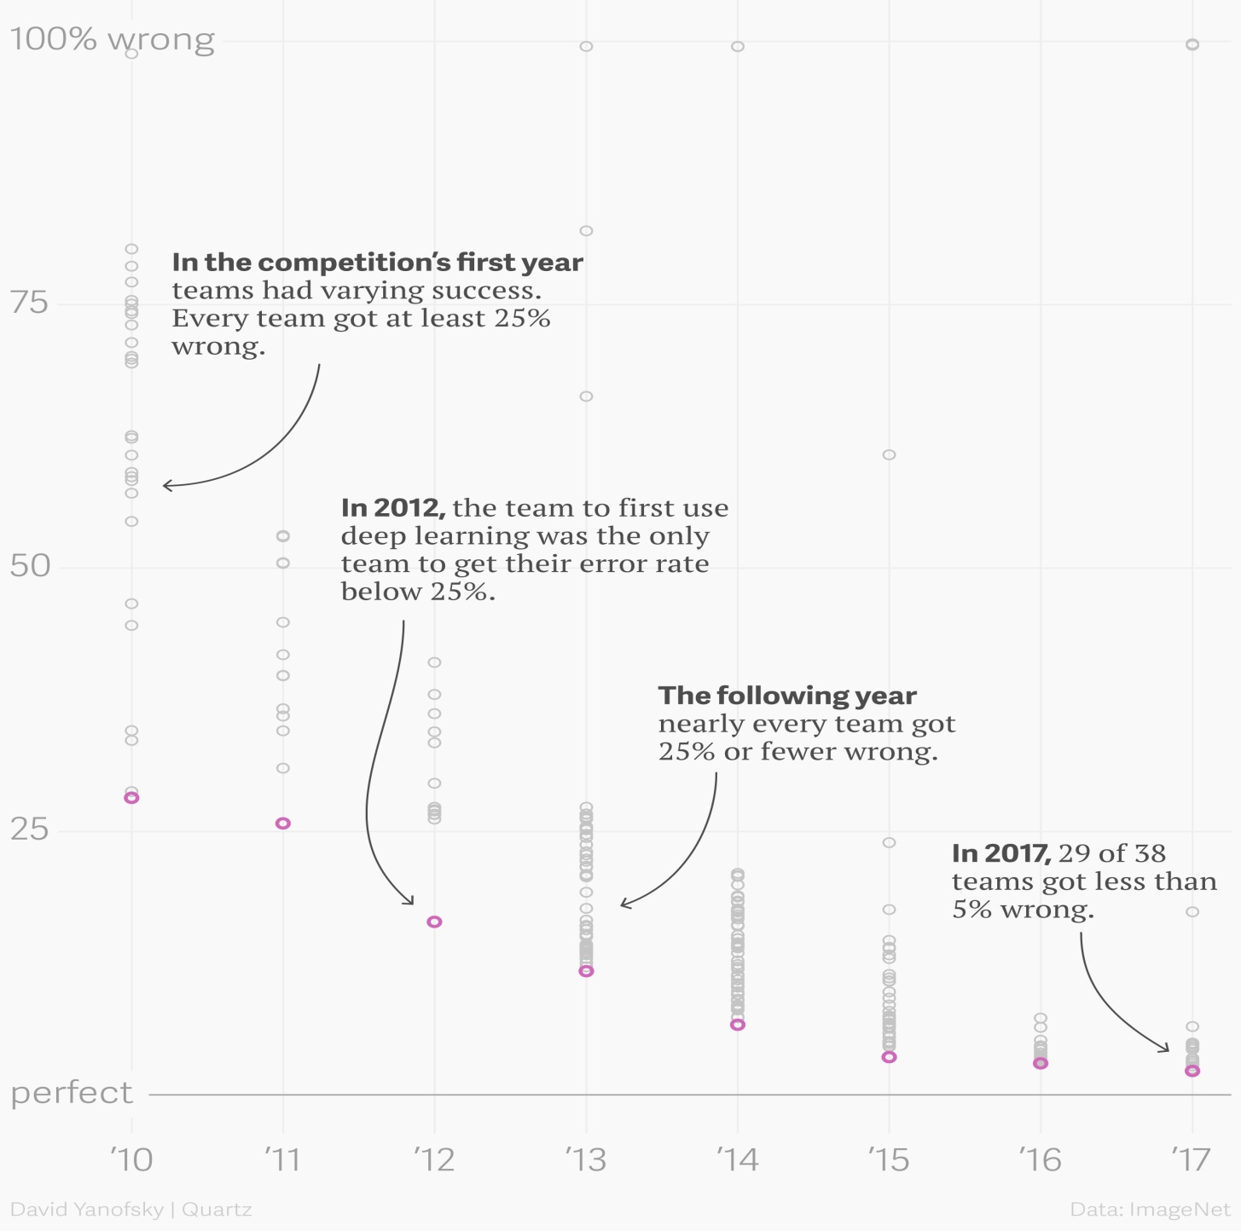
ImageNet Large Scale Visual Recognition Challenge Results

Slide 9
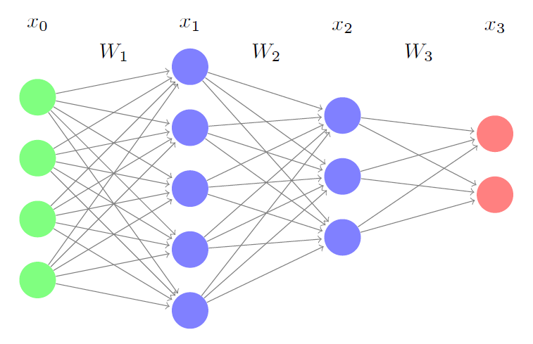
Neural Networks
Forward propagation:
x _{i} = f_{act} (W _{i} ∙ x _{i - 1})
Backpropagation (for learning weights via gradient descent):
W _{i} = W _{i} – α ∙ ∂J/∂W_{i}
Lots of matrix calculations!
Image from sudeepraja.github.io

Slide 10
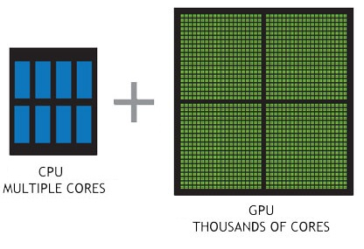
Graphics Processing Units (GPUs)
Essentially, GPUs are computer video cards
Designed for processing parallel workloads efficiently
Using CUDA (parallel computing platform and API from NVIDIA) and specially designed matrix computation libraries (such as Torch, Theano, TensorFlow and MxNet), even large neural networks can be trained very efficiently
Image from nvidia.ca

Slide 11
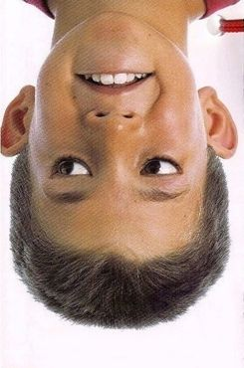
Convolutional Neural Networks (CNNs)
Inspired by connectivity patterns between neurons in human and animal visual cortex
Convolutional neural units only process data within their receptive fields
The outputs of these neurons are then processed together in the next layers to form a bigger picture
Image from moillusions.com

Slide 12
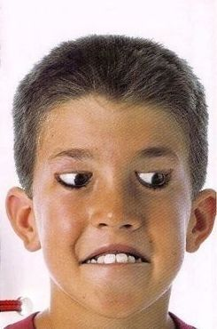
Convolutional Neural Networks (CNNs)
Inspired by connectivity patterns between neurons in human and animal visual cortex
Convolutional neural units only process data within their receptive fields
The outputs of these neurons are then processed together in the next layers to form a bigger picture
Image from moillusions.com

Slide 13
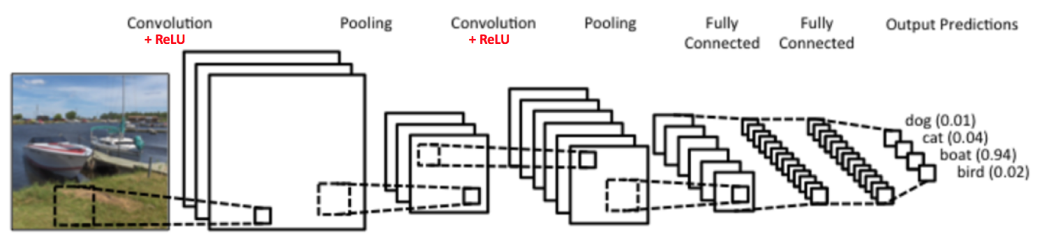
Convolutional Neural Networks (CNNs)
Can automatically classify pictures with near-human accuracy for many trained classes
Typically, very little preprocessing is required
Image from clarifai.com

Slide 14
Some modern CNN architectures
LeNet (1990) – one of the first successful CNNs (5 layers)
AlexNet (2012) – deeper and wider version of LeNet, winner of the ImageNet challenge (8 layers)
VGGNet (2014) – showed that the depth of the network is critical for good performance (16-19 layers)
GoogLeNet, aka Inception V1 (2014) – drastically reduced the number of parameters in AlexNet by using an Inception Module, which stacks 1x1, 3x3 and 5x5 convolutions within the same module of the network (22 layers)

Slide 15
Some modern CNN architectures (continued)
ResNet (2015) – a very deep CNN with inputs to later layers being sums of outputs from previous layers; many modern state-of-the-art networks are based on it (usually 50 – 200 and possibly even 1000 layers)
DenseNet (2016) – a CNN that has each layer connected to every other layer in a feedforward fashion (usually 100- 200 layers)
Xception (2017) – replaced the standard Inception modules with depthwise separable convolutions (36 layers)
Dual-Path Network (DPN) (2017) – combines the architectures of ResNet and DenseNet (92 layers)

Slide 16
Typical Deep Learning Flowchart
Keras
Gluon
Torch
Theano
TensorFlow
MXNet
cuDNN
CUDA
GPU

Slide 17
Key techniques used by winners
Getting lots of high-quality external data
Effective training design (state-of-the-art CNNs, Adam optimizer)
Using strong GPU hardware
Good validation, not overfitting to public leaderboard
Ensembling & blending (or stacking)
Pseudo Labeling
Test-Time Augmentation (TTA)

Slide 18
Gradient Descent Algorithms
Used to find a local minimum
Batch gradient descent – calculated on the entire training set – guaranteed to converge to a local minimum for small α
Stochastic gradient descent (SGD) – calculated on just one randomly chosen example for each step
Mini-batch gradient descent – calculated on a small random batch of training examples
W _{i} = W _{i} – α ∙ ∂J/∂W_{i}

Slide 19
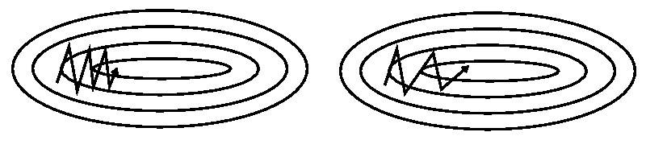
Gradient Descent Algorithms (continued)
SGD with momentum
Nesterov SGD
Same as momentum, but tries to look ahead: ∂J/∂W_{i} is calculated at W _{i} – γ ∆W _{i-1}
W _{i} = W _{i} – ∆W_{i}
∆W _{i} = γ ∆W _{i-1} + α ∙ ∂J/∂W_{i}
No momentum
Momentum
Image from ruder.io/optimizing-gradient-descent /

Slide 20
Gradient Descent Algorithms (continued)
Learning rate α is very important in optimizing SGD performance
Many methods (e.g. AdaGrad, AdaDelta, RMSProp, Adam) use different values of α for different parameters, choosing larger values for sparse ones
Adam (for Adaptive Moment Estimation), designed to combine the advantages of AdaGrad and RMSProp, seems to give the best performance in many cases
Image from ruder.io/optimizing-gradient-descent /

Slide 21
Ensembling
A very popular technique whereby the predictions of several diverse machine learning models are combined to improve upon the accuracy of each model
In many cases leads to a several percent increase in accuracy of predictions

Slide 22
Ensembling Example
Have 3 independent classifiers, each 70% accurate
Combine their predictions by majority rule
70% * 70% * 70% = 34.3% all three correct
3 * 70% * 70% * 30% = 44.1% two correct
Ensemble accuracy: 34.3% + 44.1% = 78.4% !
Based on mlwave.com/kaggle-ensembling-guide/

Slide 23
Ensembling (continued)
(90%, 80%, 80%) -> 92.8% !
(90%, 90%, 55%) -> 90.9% !
(90%, 70%, 70%) -> 86.8% ☹
When have many models, can use Pearson’s correlation coefficients to choose the most uncorrelated models for ensembling
Based on mlwave.com/kaggle-ensembling-guide/

Slide 24
Stacking and Blending
A two-step approach to classification
Idea: train a first layer of classifiers and use their outputs (i.e. probabilities) to train a second layer of classifiers
The second layer is trained on cross-validation sets (stacking) or on a separate hold-out set (blending)

Slide 25
Pseudo Labeling
Train your model on the training set
Assign labels (pseudo-labels) to test set
Train model again on combined training + test set, using the pseudo-labels for the latter
Example of semi-supervised learning
Helps the model better learn the structure of data
Not overfitting to the test set since we don’t know the true labels

Slide 26
Test-Time Augmentation (TTA)
Deep neural networks need large amounts of training data for good performance
Data augmentation creates new training samples by applying certain procedures to the original data, such as random rotations, shifts, flips, etc. for images
In test-time augmentation, the same technique is used on the test data in order to average resulting predictions and improve overall accuracy

Slide 27
Kaggle Leaderboards
Kaggle competitions always have a public and a private leaderboard. These are usually created by randomly splitting the data, but sometimes are separated in time or chosen in another way.
During the competition, participants receive feedback about their performance on the public leaderboard, while the private leaderboard remains secret until the end of the competition. The private leaderboard determines the final competition winners.
The purpose of this division is to prevent people from winning by overfitting to the public leaderboard. Participants are motivated to make sure their models will generalize well to the private leaderboard test set.

Slide 28
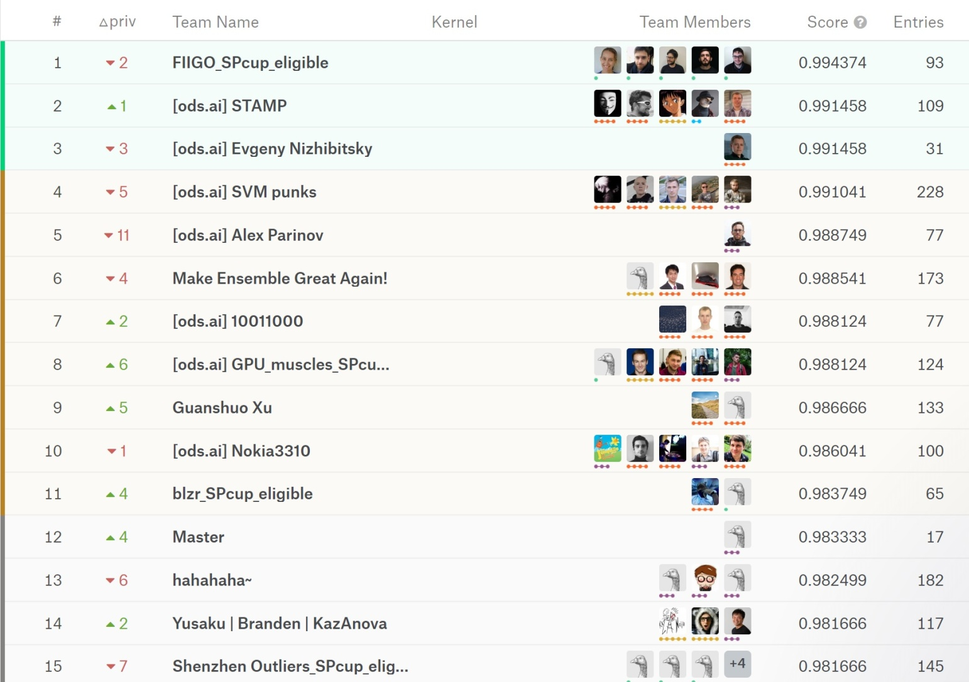
Public Leaderboard

Slide 29
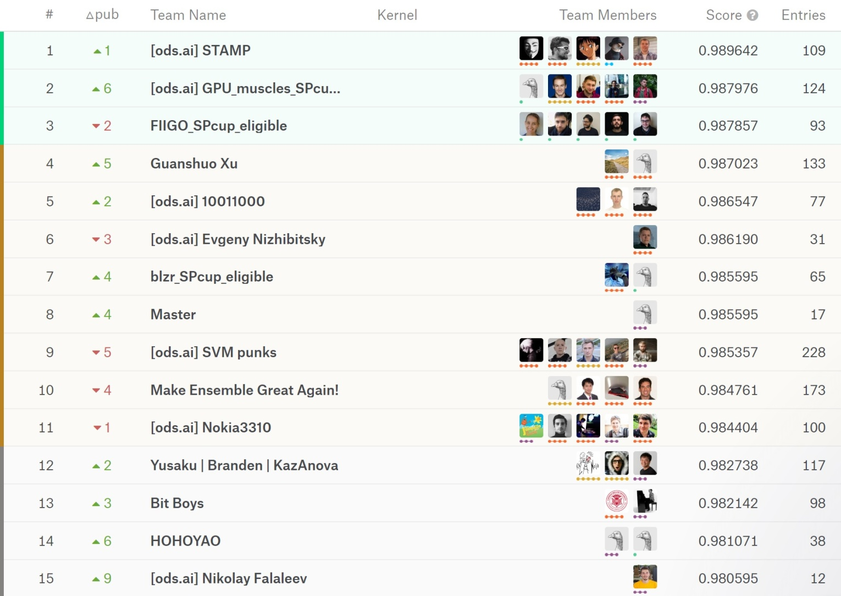
Private Leaderboard

Slide 30
1st Place Solution ([ods.ai] STAMP)
300 Gb of external data; used 20,000 photos for training and 50,000 for blending
Full-size crop (512) + TTA 8
Ensemble of Different CNN implementations ( Resnet, DenseNet, etc )
52 different models for blending: XGBoost (20) + LightGBM (20) + Keras (12)
5 NVIDIA 1080ti GPUs + 1070

Slide 31
2nd Place Solution ([ods.ai] GPU_muscles)
500+ GB of external data; trained on about 75,000 images; used 1,000 for validation
480 pixel-sized inputs to models, TTA10 (5 crops + flip), TTA 40 for some models (90∘ rotations added)
10 different CNN models (4 DenseNet, 4 ResNet, 2 DPN)
27 model checkpoints averaged by geometric mean
13 NVIDIA GPUs (9 1080ti, 2 Titan X, 2 1080)

Slide 32
3rd Place Solution (FIIGO_SPcup_eligible)
First by far on public LB (overfitting!)
Used much less external data than the top 2 winners (4,000 images for training, 500 for validation)
Different input sizes of images with random 90-degree rotations
5 CNNs (DenseNet, Resnet, Inception, Xception)
Final prediction based on arithmetic mean
A single NVIDIA Tesla P100 GPU w 16GB of RAM

Slide 33
30th Place Solution (Andres Torrubia)
Both 1st and 2nd place teams’ solutions were based on Andres’ code
First posted code without restrictions, then added a clause that it can only be used by solo participants to discourage teams with lots of GPUs
Several high-scoring teams claimed that they forked the code before the clause was added

Slide 34
General Kaggle Strategy Ideas
If you want to succeed, tend to choose competitions based on available resources
However, even with limited resources a high score is possible with a good approach
Choose final submission based on validation, not on public leaderboard
Don’t share you code if your goal is to score high ☺

Slide 35
Links for Further Study
Convolutional Neural Networks:
ujjwalkarn.me/2016/08/11/intuitive-explanation-convnets/
adeshpande3.github.io/The-9-Deep-Learning-Papers-You-Need-To-Know-About.html
Gradient descent:
ruder.io/optimizing-gradient-descent/
machinelearningmastery.com/adam-optimization-algorithm-for-deep-learning/
Ensembling:
mlwave.com/kaggle-ensembling-guide/

Slide 36
Thank you! Questions?

Slide 37
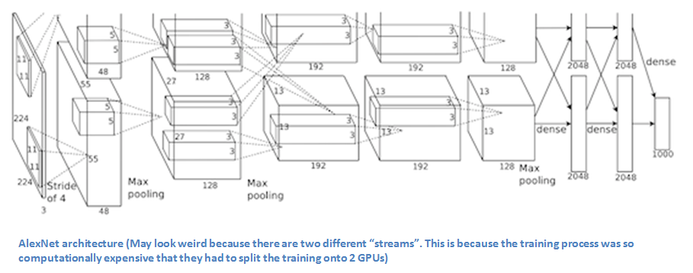
AlexNet
Image from adeshpande3.github.io

Slide 38
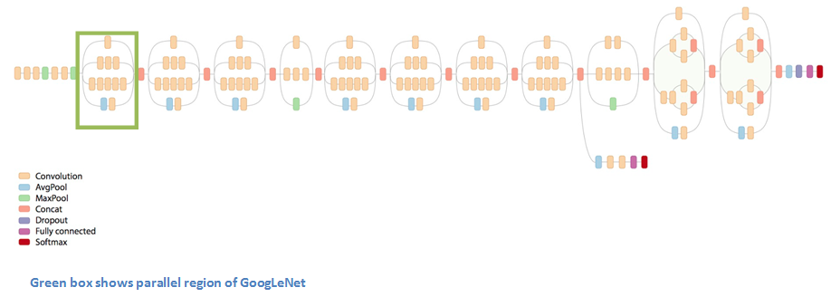
GoogleNet
Image from adeshpande3.github.io

Slide 39
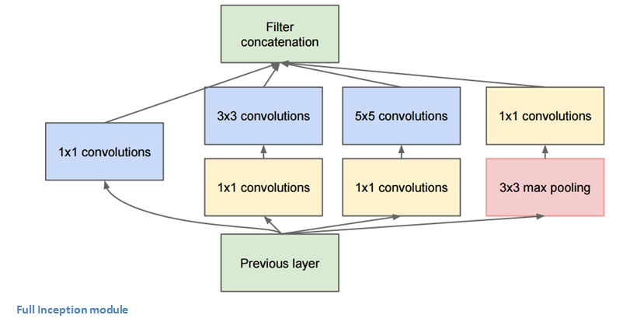
GoogleNet Inception Module
Image from adeshpande3.github.io

Slide 40
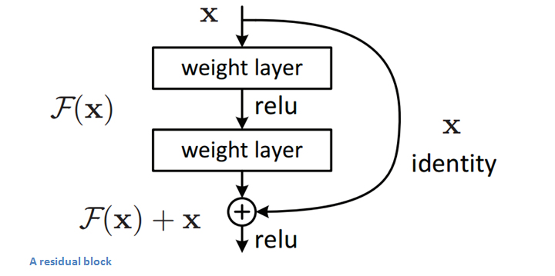
ResNet Residual Block
Image from adeshpande3.github.io

Slide 41
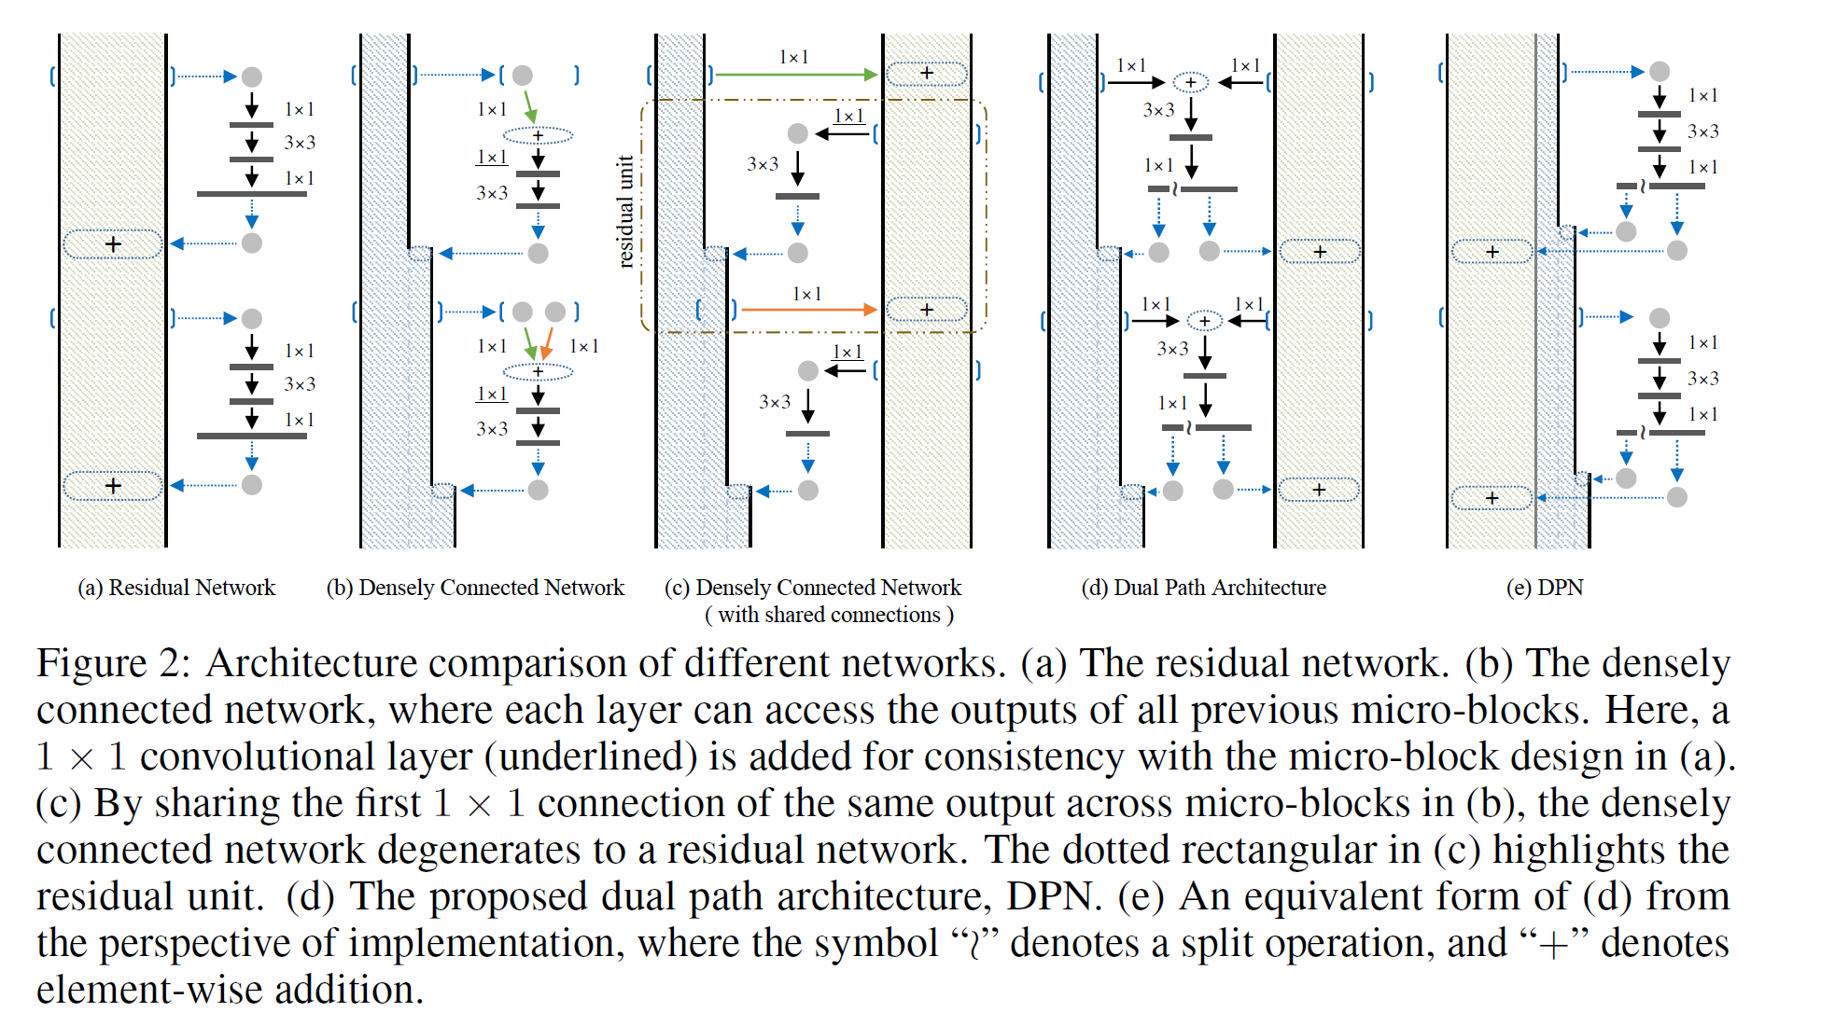
Dual-Path Network (DPN)

